Slide 1
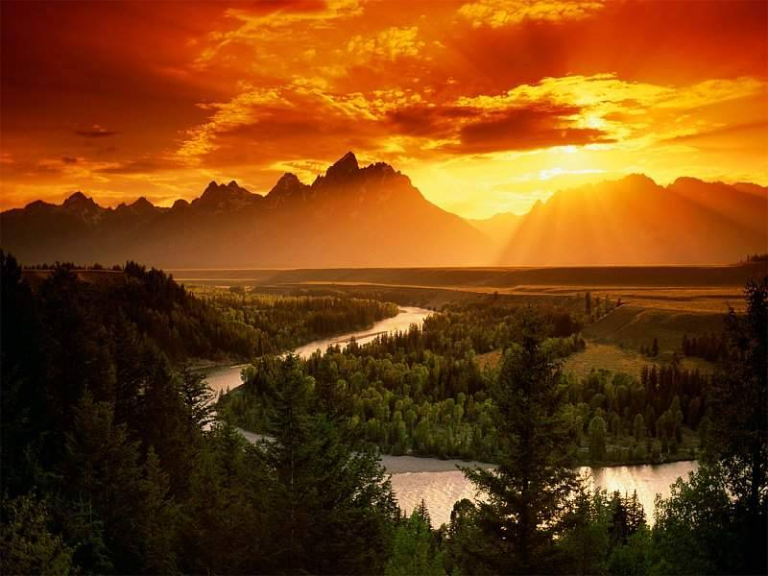
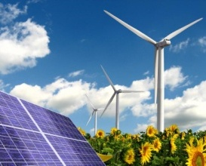
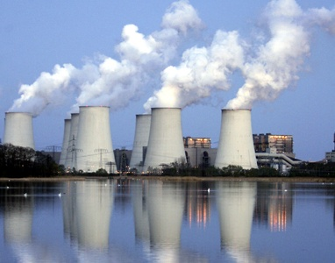
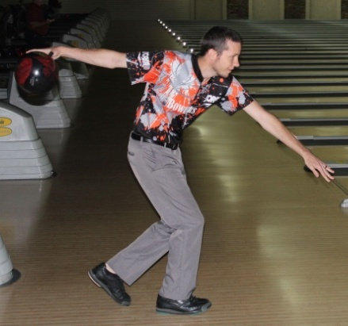
Lab 8: Energy
Sources of Energy & Forms of Energy
Fossil Fuel: The vast amount of energy we use today comes from sunshine that hit the Earth millions of years ago. Algae used sunshine to synthesize sugars and chains of sugars (starch & cellulose). After dying, bacteria stripped away oxygen, nitrogen, and phosphorus atoms. This left a gelatinous mass of carbon and hydrogen (hydrocarbons). After being buried under a mile or two of sediment, it formed petroleum (a fossil fuel). Ancient forests did the same thing; however, after they died and got buried, they turned into coal (another fossil fuel).
Examine Energy Efficiency, Conservation of Energy, and Waste Heat.
Daily Source of Energy: The energy in sunshine that we get daily is still used by plants to make sugar and chains of sugar (cellulose). The sugar gives us and all animals food energy. The cellulose (main component of wood) can be burned for heat energy. Daily sunshine can also provide power for solar panels. It also causes air to move (wind), which we can convert into electricity using wind generators. Daily sunshine also causes water to evaporate which often leads to rain. If that rain falls in mountains, the runoff can be trapped by dams to form lakes (reservoirs). Water can be channeled to fall through pipes and turbines to make electricity (hydroelectric power ). Hydro means water. Also on a daily basis the sun and moon cause tides. That motion can also be converted to electricity. Using the daily output of the sun is renewable energy because it comes back every day. Using fossils fuels (natural gas, petroleum, and coal) will only come back in a few million years.
Energy not from Sun: The only two energy sources that are not coming from the sun are nuclear energy, which comes from radioactive elements in the soil, and from geothermal energy, which comes from the heat of the original formation of the Earth and from radioactive decay within the Earth.
Forms of Energy: There are two basic types of energy: Potential Energy (stored energy) and Kinetic Energy (Energy from motion). The bowling ball here has potential energy because it is high above the ground. That energy is converted to kinetic energy as it swings to the floor. Other forms of Potential Energy with examples are Chemical (gasoline), Nuclear (uranium), Gravitational (raised bowling ball/dammed water), and Mechanical energy (a compressed spring). Other forms of Kinetic Energy and examples are Motion (object in motion), Thermal (atoms in motion), Sound (vibration of atoms), Electromagnetic & Radiant (radio, infrared, visible, UV, X-rays), and Electrical (motion of electrons).
Notes:
Electroluminescence Advantages: Indiglo (brand name) -Low wattage -Long life -No external circuitry required (no ballast needed to limit current, it can be plugged directly into AC power and will self-regulate power through it's own resistivity) -Can be manufactured into flat flexible panels, narrow strings, and other small shapes -Can be made into waterproof computer monitors which are more durable and light weight than LCDs or Plasma screens. -Not directional like LCDs when used as a computer monitor, looks good at all angles -EL displays can handle an impressive -60 C to 95 C temperature range, which LCD monitors cannot do
Disadvantages: -Not practical for general lighting of large areas due to low lumen output of phosphors (so far) -Poor lumens per watt rating, however typically the lamp is not used for high lumen output anyway -Reduced lumen output over time, although newer technologies are better than older phosphors on this point -Flexible flat EL sheets wear out as they get flexed, durability is being worked on -The lamps can use significant amount of electricity: 60-600 volts -Typical EL Needs a converter when used with DC sources such as on watches (to create higher frequency AC power, this is audible)

Slide 2
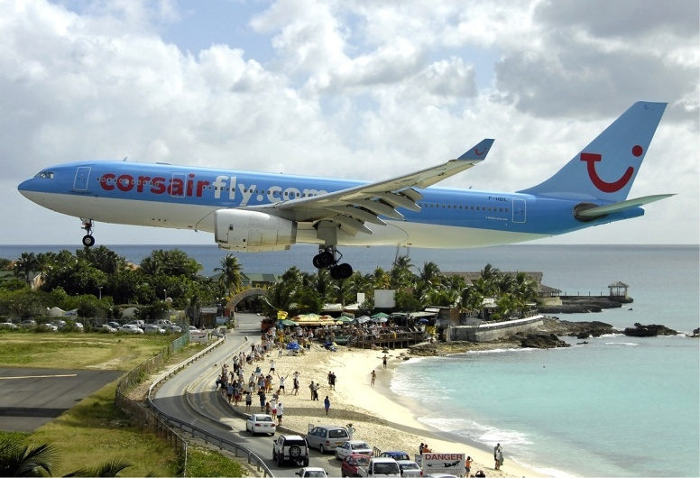
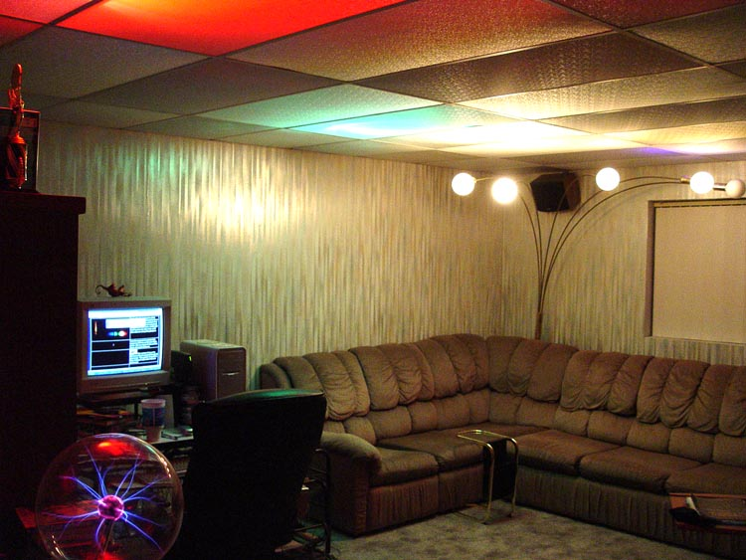
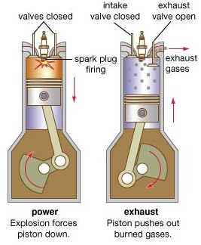
Lab 8: Energy
Conservation of Energy (& Energy Conversion)
Energy use: All societies use energy to carry out activities they believe are important. This includes transportation, lighting, construction, entertainment, and much more. Even though energy is said to be consumed, the truth is the energy was just converted to another form. For example, the plane started with thousands of gallons of fuel (chemical energy) that gets consumed in flight. However, that energy is not gone but remains as mostly thermal energy in the air where the exhaust left the plane. Another example, is when we use lights
around the home. We think we are “burning up” electricity. But even when we turn off the lights, the energy used to turn on the lights is still there. It’s still around as extra heat in the room. If winter, this left over heat is a bonus.
Conversion example #1. Let’s say you turn on a desk lamp. At that point electrical energy (voltage and current) turns into thermal energy as it makes the filament white hot. As it glows the thermal energy is converted to radiant energy (light). More specifically, ultraviolet, visible, and infrared light. As light bounces around the room, most of it gets
absorbed by items in the room and the light energy turns to heat energy again. If your eyes are open, the visible light energy that enters the eye gets converted to chemical energy as the light is absorbed by a protein named Rhodopsin in the eye. Photons of UV light have more energy than visible light and are capable of breaking bonds or creating new bonds in fabric, paint, and even on your body (including eye). Breaking bonds release heat energy; forming bonds store chemical energy. Again, the light bulb may be off, but the energy used to turn it on is still around in some form with thermal (heat) energy being the most prominent form.
Conversion example #2: Sunshine (radiant energy) is absorbed by ancient algae to make sugar (chemical energy). Over time this transforms to petroleum, which contains gasoline (still chemical energy). In a car’s engine, combustion of gasoline & oxygen makes H₂O and CO₂. The breaking of gasoline bonds converts chemical energy to thermal energy which heats up the H₂O and CO₂ gases causing high pressure in the cylinder. High pressure pushes the piston down (mechanical energy) which spins the crankshaft (kinetic energy). About 80% of the thermal energy from combustion exits the tail pipe and radiator and is wasted. Some kinetic energy of the crankshaft is converted to electrical energy by the alternator. If the radio is on, some electrical energy turns into sound (vibrational energy). Much of the energy of the spinning crankshaft transfers to the wheels causing the car to move (kinetic energy). A moving car pushes against the air causing the air to move faster. That ends up heating the air (thermal energy). Unless a car is driving up hill, about 99% of the original chemical energy from gasoline becomes thermal energy. Thermal energy is usually the last form of energy that results from using other forms of energy.
The chemical energy from sing gasoline
Notes:
Electroluminescence Advantages: Indiglo (brand name) -Low wattage -Long life -No external circuitry required (no ballast needed to limit current, it can be plugged directly into AC power and will self-regulate power through it's own resistivity) -Can be manufactured into flat flexible panels, narrow strings, and other small shapes -Can be made into waterproof computer monitors which are more durable and light weight than LCDs or Plasma screens. -Not directional like LCDs when used as a computer monitor, looks good at all angles -EL displays can handle an impressive -60 C to 95 C temperature range, which LCD monitors cannot do
Disadvantages: -Not practical for general lighting of large areas due to low lumen output of phosphors (so far) -Poor lumens per watt rating, however typically the lamp is not used for high lumen output anyway -Reduced lumen output over time, although newer technologies are better than older phosphors on this point -Flexible flat EL sheets wear out as they get flexed, durability is being worked on -The lamps can use significant amount of electricity: 60-600 volts -Typical EL Needs a converter when used with DC sources such as on watches (to create higher frequency AC power, this is audible)

Slide 3
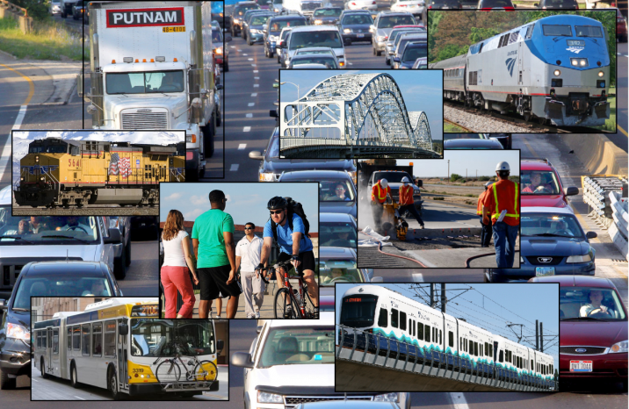
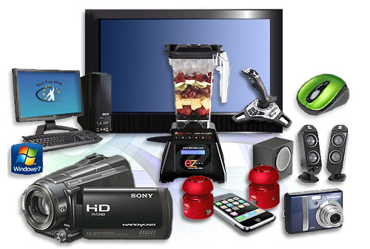
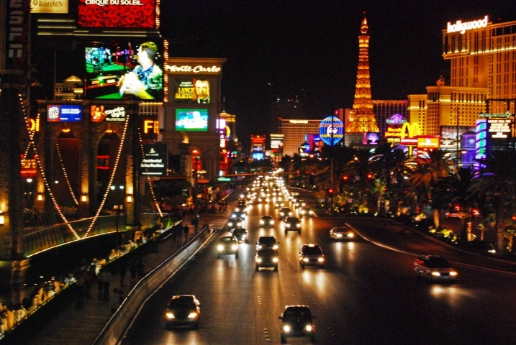
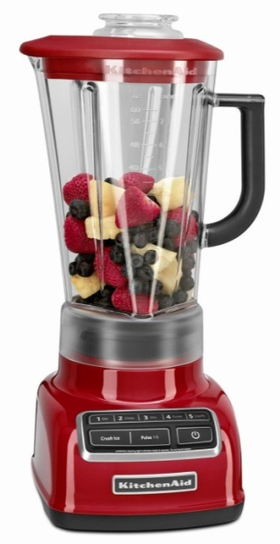
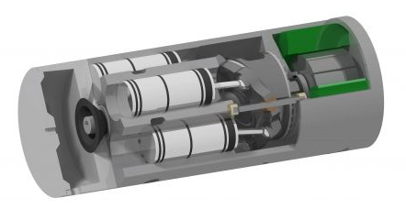
Lab 8: Energy
Waste Heat
Waste Heat: Energy is used for many things such as transportation, lights, and the running of our appliances and entertainment devices. Unfortunately, much of this energy gets converted to heat that wasn’t wanted. So that is waste heat. For example, a camcorder uses battery power to record video and to display it on the screen; however, electrical resistance in the electronics causes the camcorder to heat up. So some of the battery power (chemical energy) gets wasted in heating up the camcorder. Unless you had cold hands, this extra heat is a waste of energy.
Blender’s Waste Heat: A blender is a good example of energy getting converted to unwanted heat. We want electricity to simply blend the food and that’s all. Unfortunately, the powerful motors in blenders need a lot of electrical current to flow though coils of wires to make a strong electromagnet that pull and push on other magnets to spin the motor. Electrons passing through the wires bump into stationary copper atoms (electrical resistance). That causes the copper atoms to vibrate which results in heat. To keep the blender from overheating, a fan is used to blow away this heat. The spinning blades that blend the food also encounters friction with the food and that warms up the food. About 95% of the electrical energy that goes into the blender is turned into heat (Waste Heat). Only about 5% is used to blend the food. If the copper wire was replaced with superconducting wire there would be no heating of the wire and the blenders could use a much smaller electric motor.
Solution to Waste Heat: The best way to avoid spending money and energy resources on items that turn much of it into waste heat is to use items that are much more efficient. That’s because in places like Arizona where it’s usually hot, inefficiency costs double. First there’s the cost to operate the item and then there’s the cost to cool down the home, house, or business due to the waste heat the item released. Another way to deal with waste heat is to find a way to use that heat or use technology that can make that heat do some work. For example, a car produces a lot of heat. Some people use the heat of the engine or the exhaust for cooking. So not all of that heat is being wasted. Some car companies have tried to capture the heat in the exhaust and use it to generate electricity. For example, in the diagram, exhaust heat evaporates a liquid that pushes on the pistons that turn a crankshaft (like a miniature engine).
Notes:
Electroluminescence Advantages: Indiglo (brand name) -Low wattage -Long life -No external circuitry required (no ballast needed to limit current, it can be plugged directly into AC power and will self-regulate power through it's own resistivity) -Can be manufactured into flat flexible panels, narrow strings, and other small shapes -Can be made into waterproof computer monitors which are more durable and light weight than LCDs or Plasma screens. -Not directional like LCDs when used as a computer monitor, looks good at all angles -EL displays can handle an impressive -60 C to 95 C temperature range, which LCD monitors cannot do
Disadvantages: -Not practical for general lighting of large areas due to low lumen output of phosphors (so far) -Poor lumens per watt rating, however typically the lamp is not used for high lumen output anyway -Reduced lumen output over time, although newer technologies are better than older phosphors on this point -Flexible flat EL sheets wear out as they get flexed, durability is being worked on -The lamps can use significant amount of electricity: 60-600 volts -Typical EL Needs a converter when used with DC sources such as on watches (to create higher frequency AC power, this is audible)

Slide 4
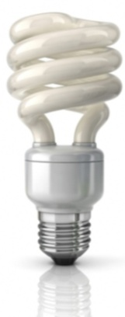
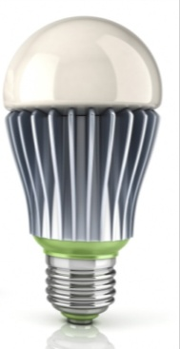
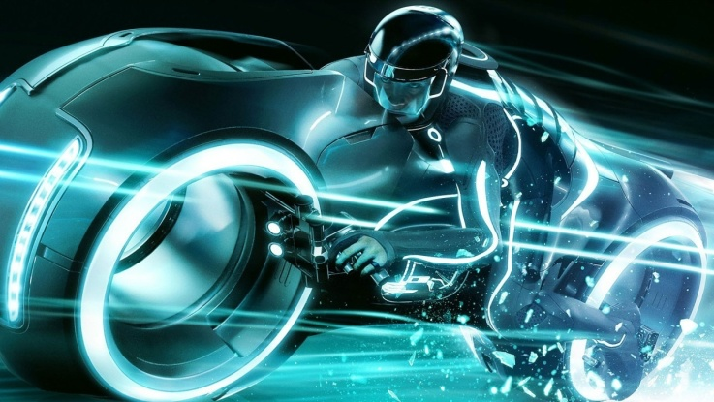
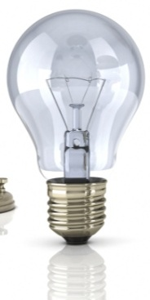
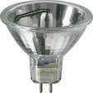
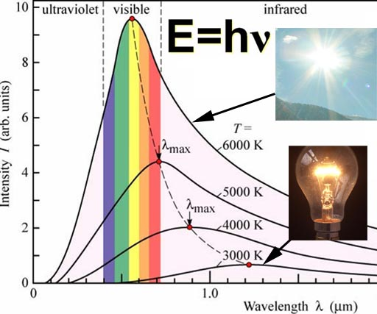
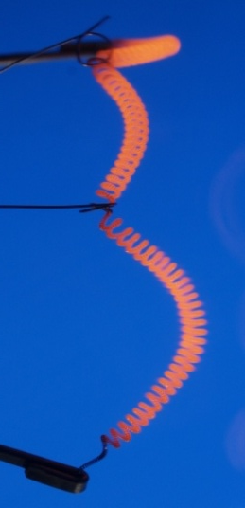
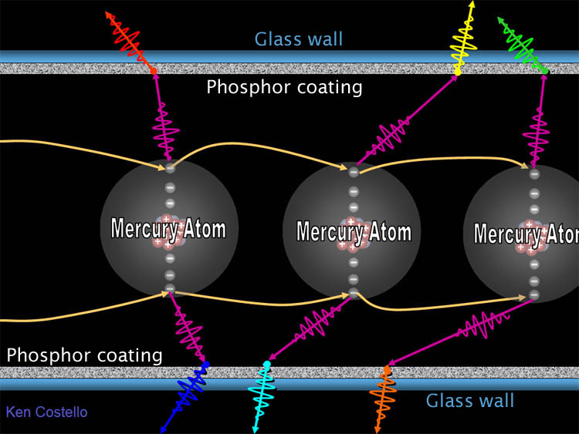
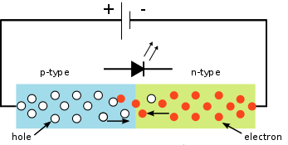
Lab 8: Energy
Energy efficiency of lighting
Incandescent Halogen Fluorescent LED Electroluminescence
Incandescent bulbs: Halogen and standard incandescent bulbs both depend on heating up a tungsten filament until it glows. Halogen bulbs contain a halogen such as iodine or bromine which lengthens the life of the tungsten filament. The temperature of the filament for a standard incandescent bulb is about 2700 Kelvin. That means about 95% of the light it creates is in the infrared region that we cannot see. A halogen bulb filament is about 3200 Kelvin so its output shifts closer to visible light making it a little more efficient.
Wavelength () in m
Fluorescent bulbs: Fluorescent lamps have a different strategy for making light. They use high voltage to cause electrons to jump from mercury atom to mercury atom. As electrons fall into orbit around a mercury atom, they give off a photon (packet) of ultraviolet light. When a UV photon strikes phosphors that coat the inner wall of the fluorescent tube, the phosphors absorb the UV light and emit visible light of specific wavelengths. The below spectrum shows that one particular fluorescent lamp had phosphors that emitted blue, turquoise, green, yellow, and red light. The corresponding
wavelengths for these colors are 440nm, 495nm, 540nm, 590nm, & 620nm. Our eyes perceive them together as white light.
LEDs and Electroluminescence: Both LEDs and Electroluminescent lights are based on electrons jumping across two different materials. In LEDs low voltage pushes electrons across the junction between p-type and n-type semi-conductors. When electrons fall into the holes, they give off light. In electroluminescent lights, alternating high voltages cause electrons to jump from an insulator layer to a layer of phosphors.
Notes:
Electroluminescence Advantages: Indiglo (brand name) -Low wattage -Long life -No external circuitry required (no ballast needed to limit current, it can be plugged directly into AC power and will self-regulate power through it's own resistivity) -Can be manufactured into flat flexible panels, narrow strings, and other small shapes -Can be made into waterproof computer monitors which are more durable and light weight than LCDs or Plasma screens. -Not directional like LCDs when used as a computer monitor, looks good at all angles -EL displays can handle an impressive -60 C to 95 C temperature range, which LCD monitors cannot do
Disadvantages: -Not practical for general lighting of large areas due to low lumen output of phosphors (so far) -Poor lumens per watt rating, however typically the lamp is not used for high lumen output anyway -Reduced lumen output over time, although newer technologies are better than older phosphors on this point -Flexible flat EL sheets wear out as they get flexed, durability is being worked on -The lamps can use significant amount of electricity: 60-600 volts -Typical EL Needs a converter when used with DC sources such as on watches (to create higher frequency AC power, this is audible)

Slide 5
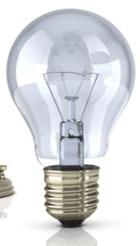
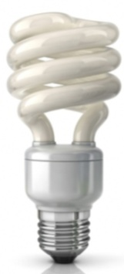
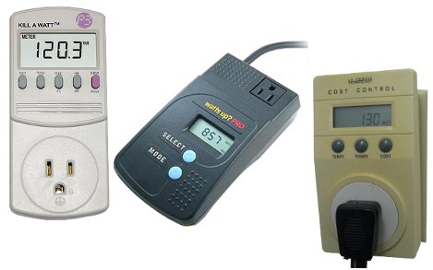
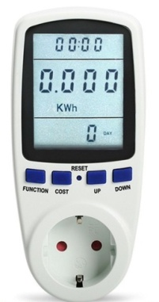
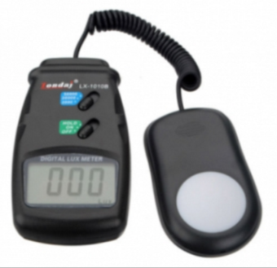
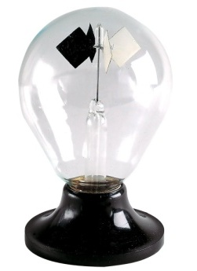
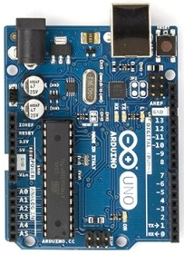
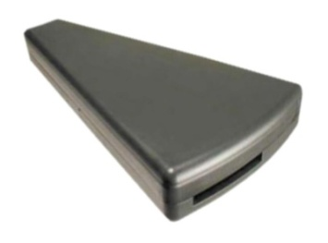
Lab 8: Energy: Measure light bulb efficiency
Watt meters
Incandescent Halogen Fluorescent LED
1) Measuring wattage : Hook up these 4 types of bulbs to a watt meter and record their watts consumption.
Incandescent: ______ watts Halogen: ______ watts Fluorescent: ______ watts LED: ______ watts
Light Meter: These kind of light meters are measuring how much visible light is hitting a surface. They do not register infrared or ultraviolet light. They are used by photographers to set camera exposure and by architects who want to design the right amount of light to light up work areas. These meters measure in a unit called a Lux. Light bulbs are often labeled with their brightness in lumens which represent the total amount of visible light coming from the bulb. Lux measures the amount of light that is spread out over a certain area away from the bulb.
2) Measure brightness using light meter: Use a light meter to measure the lux at 12 inches away from each of the below bulbs. (Note: most smartphones also have built-in light meter)
Incandescent: _____ Lux Halogen: ____ Lux Fluorescent: ______ Lux LED: ______ Lux
Comparing bulb efficiency: Since these bulbs are have different wattages, it’s not fair to judge their efficiency by the lux value ; however, by dividing the lux value by the watt value, we get lux per 1 watt. That allows you to compare them fairly because you are discovering how many lux each watt of that bulb produces.
3) Calculate the lux per watt for each bulb: Whenever you see “per” that’s a clue to divide the measurement in front of “per” by the measurement after the “per”. In other words, the “per” is replaced with a divide sign ( ÷ or / ). So to get lux per watt, divide the lux values by the watt values for each bulb.
Incandescent:______ lux/watt Halogen:______ lux /watt Fluorescent:______ lux /watt LED:______ lux/watt
Energy wasted: In all 4 bulbs, not all of the energy being consumed (watts) is going into producing visible light. Some energy goes into producing ultraviolet light and infrared light (mostly infrared light) that we can’t see. The radiometer on the left reacts mostly to infrared light. The black surfaces absorb more of the visible and infrared light than the white surfaces. That makes the black squares hotter. This heat transfers to the argon gas around the black squares. The fast moving argon atoms strike the surface of the black square harder therefore pushing it in that direction. Shine the four lights on the radiometer and see if you can tell which one made the radiometer spin the fastest, which is likely the one that makes the most infrared.
4) Bulb that made the Radiometer spin the fastest: ________________
UV light: A bulb that produces infrared light is wasteful, but a bulb that produces UV light can be harmful to skin and eyes. Using the Arduino based UV meter, report which one is producing the most UV light.
Bulb ID with Spectroscope: A fluorescent bulb is easy to identify by its spectrum. They have bands of color in the spectrum due to the phosphors emitting certain wavelengths of light. What wavelengths are emitted by the fluorescent bulb? (The numbers are in 100’s of nanometers)
6) ________________________________
________________________________
5) _________________
Notes:
http://math.ucr.edu/home/baez/physics/General/LightMill/light-mill.html To explain the radiometer, therefore, one must focus attention not on the faces of the vanes, but on their edges. The faster molecules from the warmer side strike the edges obliquely and impart a higher force than the colder molecules. Again, these are the same thermomolecular forces responsible for Reynolds' thermal transpiration. The effect is also known as thermal creep, since it causes gases to creep along a surface that has a temperature gradient. The net movement of the vane due to the tangential forces around the edges is away from the warmer gas and towards the cooler gas, with the gas passing around the edge in the opposite direction. The behaviour is just as if there were a greater force on the blackened side of the vane (which as Maxwell showed is not the case); but the explanation must be in terms of what happens not at the faces of the vanes, but near their edges.

Slide 6
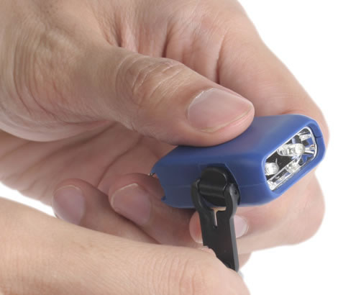
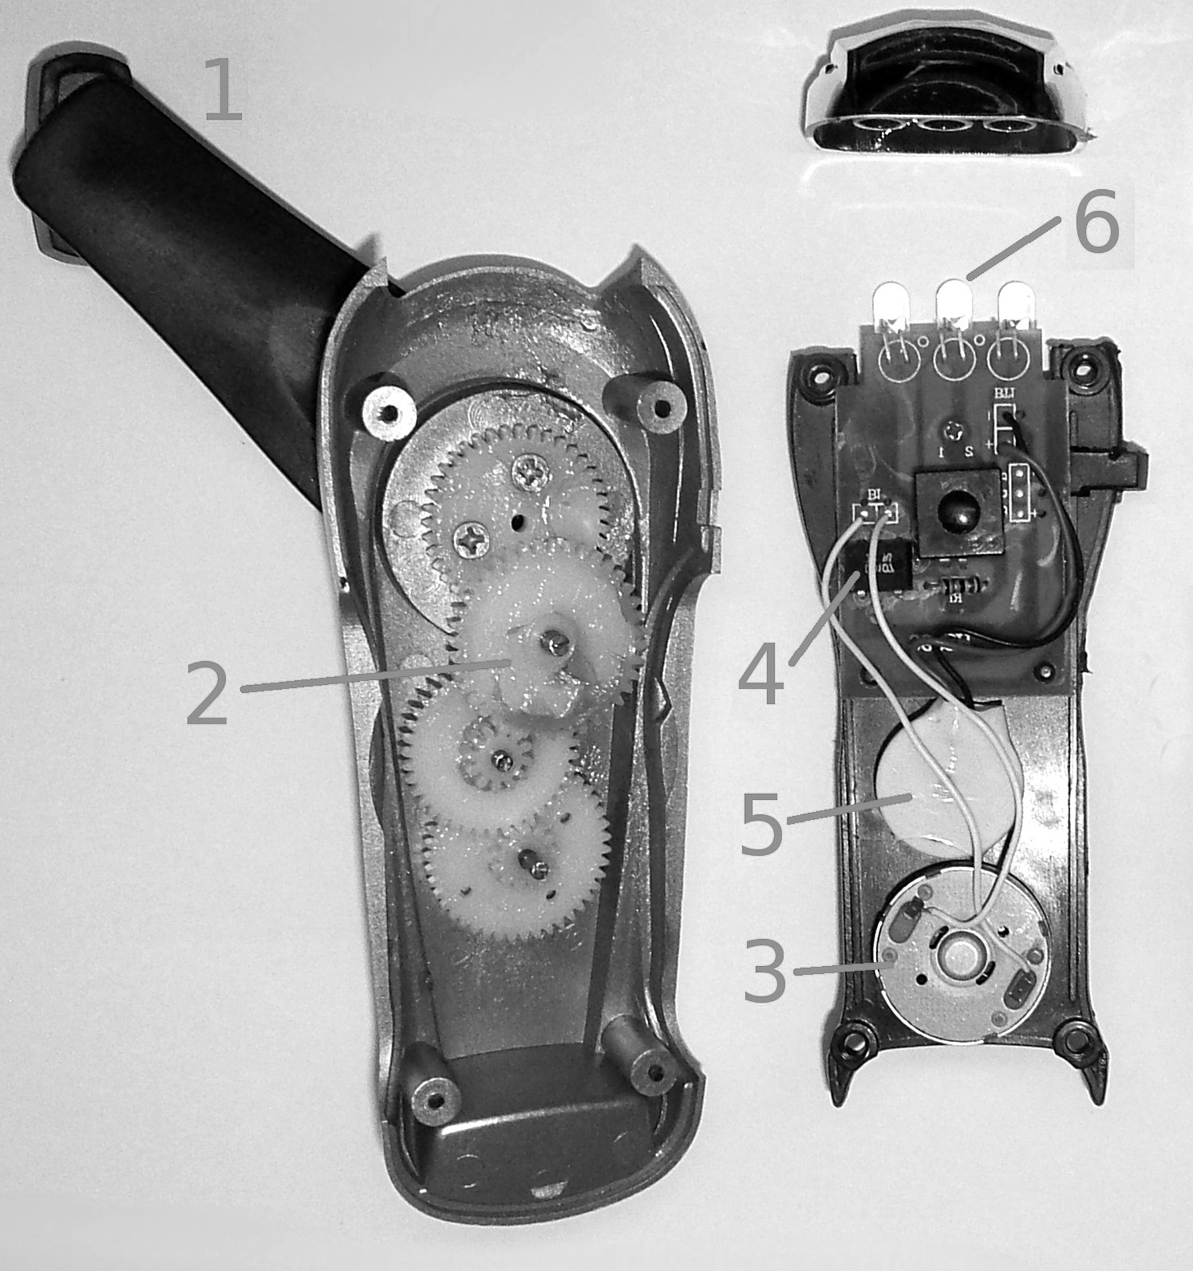
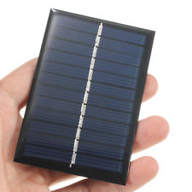
Lab 8: Energy: Energy conversion & Solar panel efficiency
Hand-cranked powered flashlight: Even though these small hand-cranked flashlights seem simple, the energy from cranking goes through many forms.
With the flashlight turned off, crank the handle about 20 revolutions. Then turn on the switch to see if the LEDs come on. The muscles in your hand require chemical energy which is converted to kinetic energy as your fingers move in a circular fashion.
1) Below is a cutaway of a larger version of a hand-cranked flashlight. The sequence of parts that transfer the energy are numbered. Match the energy conversion that is happening (A-E) to its corresponding step in the 1 through 6 sequence.
Hand crank
Multiplier gears
A/C generator
A/C to DC rectifier
Lithium battery
LED lights
A: Electrical energy to Electrical energy
B: Chemical Energy to Electrical energy then to Radiant energy
Kinetic energy to Kinetic energy
Electrical energy to chemical energy
Kinetic energy to electrical energy
Conservation of Energy vs. Conserving Energy: Note these two titles are not the same. Conservation of energy is a law in physics that says energy cannot be created or destroyed; it can only change form. In other words, it’s always conserved is some form. “Conserving Energy” means not being wasteful with energy by using products that are more efficient or having habits that consume less.
Factors that affect solar panel efficiency : Photovoltaic cells (solar panels) are a fast growing source of electrical energy. Connect the solar panel to multimeter and use the sun as a light source to illuminate the solar panel. Determine the effects of the following conditions on the output of the solar panel. You can answer the questions on the back of this page or on a separate page. Indicate the solar panel #.
2) Angle of Incidence: What happens if the solar panel is not perpendicular to the incoming light?
3) Effect of a shadow: Some types of solar panels are more negatively affected by shadows (like from a tree). Try shading about ¼ of the panel and see how the energy output is affected.
4) Effect of temperature: Solar panels are less efficient at higher temperatures. Try using ice or an air duster to lower the temperature of the solar panel. What effect did you see.

Slide 7
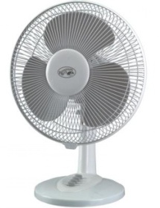
Lab 8: Energy: Waste Energy
Electric Cooling Fan: Being here in Arizona, we are very appreciative of cooling fans. From our experience we think fans are cooling the air, but they are actually heating the air. They feel like they are cooling us because the air blowing over our sweaty skin will accelerate the evaporation of the sweat. When water (sweat) evaporates, it needs to absorb energy. When it does, it cools the area around it. Even if the skin is not sweaty, there is a layer of warm air sitting right next to the skin. The fan blows that warm air away replacing it with cooler room temperature air.
1) Does a fan cool the air?: Take a reading of the air temperature before the fan is turned on. _________
2) Now turn the fan on and wait a couple of minutes. What is the temperature now? __________
Fan produces waste heat: One way to prove that a fan actually heats the air is to place it in a closed box. Place a fan into a box and insert the thermometer. Don’t let the thermometer hit a fan blade. 3) What is the initial temperature? _____________ Now turn on the fan and keep the box closed. 4) Wait about 10 minutes and check the temperature again: ____________
Except for heaters ,which are supposed to produce heat, about everything else we use also produces heat even when it’s not suppose to create heat. For example, all electronic devices (TVs, computers, cellphones, etc.) create heat as a by-product of electrical current. Only superconductors can carry electrical current and not produce heat.
5) What’s hot or warmer than room temperature?: Waste heat can be found by looking for devices that are warmer than room temperature. Use the infrared thermometer to check devices around the lab to see if they are warmer than room temperature. Transformers and light bulbs are two usual waste heat creators. List what you found that was producing waste heat below or on back of this page (or on a separate sheet of paper).
Items to take home: Spectroscope, thermometer, 100 mL graduated cylinder. Item needed at home: A blender. See online manual for details.

